Slide 1
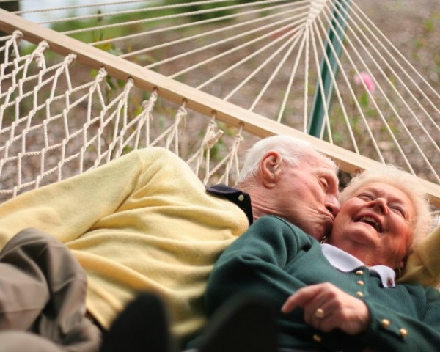
Dr Sharron Hinchliff and Stephanie Ejegi-Memeh
School of Nursing & Midwifery
Intimate relationships and sexual health in the over 50s

Slide 2
Programme of work
Since 2001 exploring:
Older age, gender, sexual health and sexual well-being
Numerous projects and publications
Underpinned by sexual rights approach

Slide 3
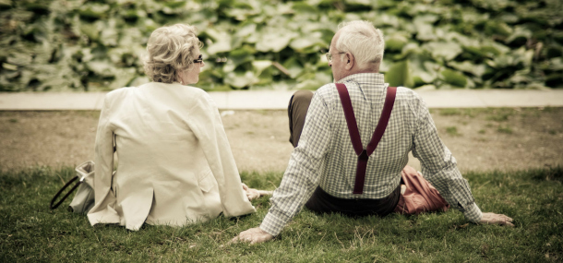
Right to equality and non-discrimination
Free from discrimination and prejudice
So we can obtain the highest standard of sexual health

Slide 4
AGEISM
Absent from sexual health campaigns
Not receiving appropriate sexual health care

Slide 5
You!

Slide 6
Let’s talk about sex
What do we already know about intimate relationships
and sexual health in the over 50s?

Slide 7
True or False?
1. Most older adults are not sexually active

Slide 8
National Survey of Sexual Attitudes & Behaviours (NATSAL) 2012
 | Past 4 weeks |  | Past year |  | Lifetime
 | Vaginal sex | Masturbation with woman | Oral sex with woman | Anal sex with women | Sex with man
Men aged 65-74 | 37.2% | 33.1 | 30.4 | 2.9 | 3.4
 | Past 4 weeks |  | Past year |  | Lifetime
 | Vaginal sex | Masturbation with man | Oral sex with man | Anal sex with man | Sex with woman
Women aged 65-74 | 23.1% | 10.3 | 19 | 3.6 | 2.6

Slide 9
True or False?
2. All older adults have sexual problems

Slide 10
True or False?
3. Older adults don’t talk about sex - to anyone!

Slide 11
True or False?
4. Older men desire sex but older women don't

Slide 12
True or False?
5. Older adults don't get sexually transmitted infections

Slide 13
Age of Love

Slide 14
Areas / booklets
What would an age friendly / sexual rights friendly community look like?
If we were to make our communities more age friendly / sexual rights friendly, what would we need to do?

Slide 15
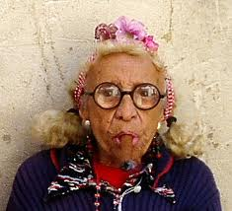
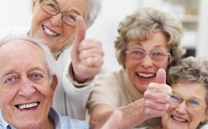
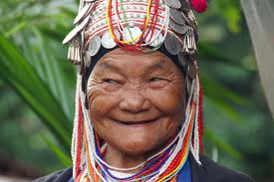
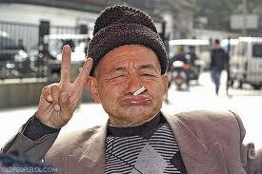
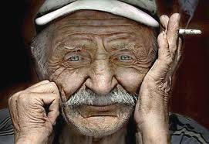
Thank you
s.hinchliff@sheffield.ac.uk / s.ejegi-memeh@sheffield.ac.uk
@DrSharronH
sharronhinchliff.com

