Slide 1
Introducing Henry and Hilda

Slide 2
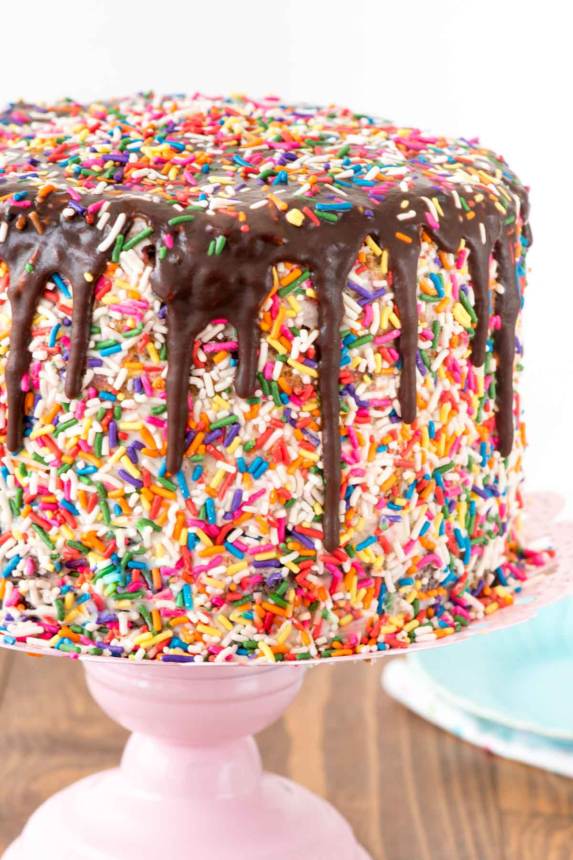
How to bake a community?
Joanne Stevenson and Joyce Thompson

Slide 3
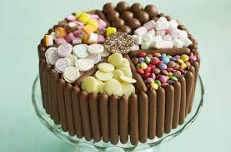
What is community?
Location
Characteristics
Belonging
Notes:
A group of people living in the same place or having a particular characteristic in common

Slide 4
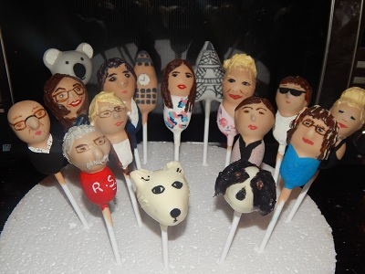
Why do we need community?
Connection and purpose. Camerados
Need to develop / use skills

Slide 5
Quote
Community — meaning for me “nurturing human connection” — is our survival. We humans wither outside of community. It isn’t a luxury, a nice thing; community is essential to our well being. Frances Moore Lappé, Author

Slide 6
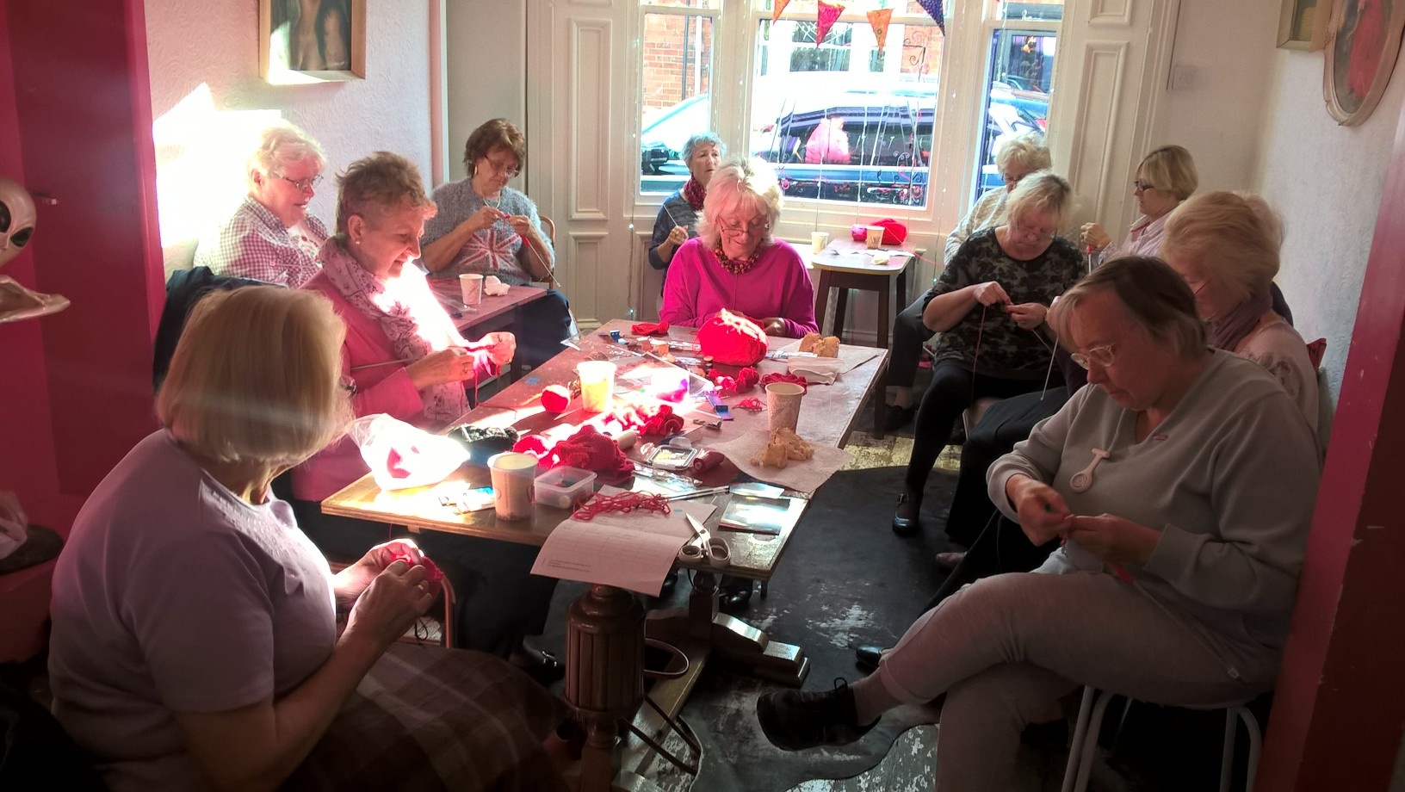
What communities we have?
Geographical
Interest
Need
Notes:
Geographical – local, Hubs, wider ABM
Interest – Family History, Can she fix it?, Egyptology
Need – Men Health Cooking, Tea & Technology, Walk and Talk, Carers Café meet up
Helper s Dinner
Length of activities

Slide 7
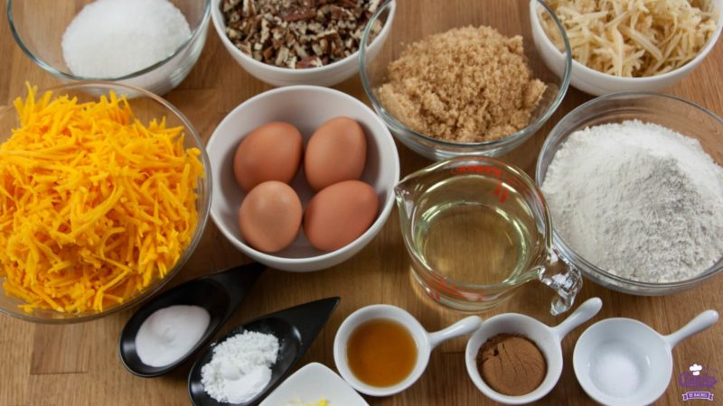
What are the ingredients of making a community?
People
Membership
Skills and Experience
Acceptance
Shared purpose
Connections
Notes:
People – participants L&I, staff, volunteers, contacts
Membership – Badge, belonging, Newsletter
Acceptance – no barriers to membership
Shared purpose
Skills and Experence

Slide 8
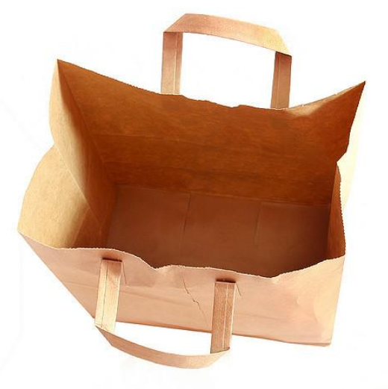
What ingredients are in short supply?
Understanding
Diversity
Finance
Skills
Experience of staff and helpers
Willingness to share information
Notes:
Understanding why its important
Diversity – diverse area but not reflected in membership, not targeting, language barriers, permission, extra invitation, mixed groups
Finance – sustainability, ABMAG fund, concerns for future
Skills – sustainability end of programme co-ordination
Experience of staff and volunteers – migration, illness, carers – share and develop skills and experiences
Council & External support – not enough staff and resources
Willingness to share information

Slide 9
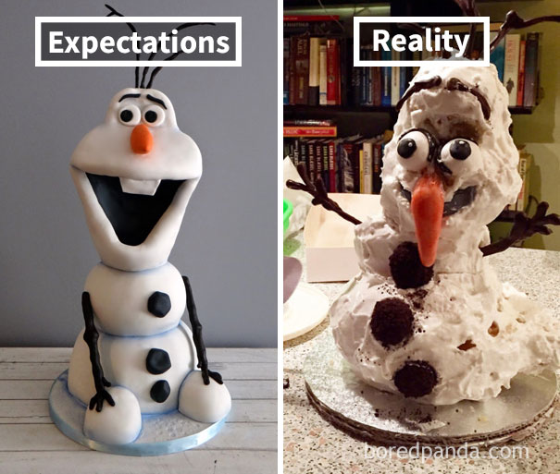
What happens when it goes wrong and what did we learn?
Diversity
Outreach
Trying hard
Too successful
Notes:
Can reach & engage them, but they struggle to come out of their communities – Chinese, hindu centre, language & culture
National picture & transport – ad hoc
Older younger people
Targeted districts
What did we learn
it takes time
build up trust
sometimes you will fail
people don’t like change – You will upset people

Slide 10
Over to you…
Tell us your story..…through the medium of cake
Think about one of your communities, the issues it currently face and how you would like to tackle them over the coming 2 years
Using the materials provided that represent the ingredients as described, it’s time to make your own ‘Community Cake’ and then share it with us

Slide 11
Over to you…
Please ensure you decorate ‘safely’

Slide 12
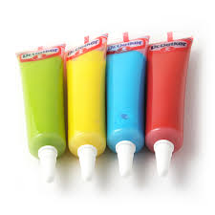
Over to you…
Red – Skills/ Experiences
Blue – Participants
Green – Resources
White – Success
Black – Challenges
Decorations – you tell us
Notes:
Consider: order, style, quality, why unique

