Slide 1
GUEST SPEAKER
Sophy Proctor
Head of Funding (Ageing Better)
The National Lottery Community Fund
#ABCelebration
Sheffield City Hall
9 - 10 July 2019

Slide 2
Reach
Ageing Better Legacy and Learning

Slide 3
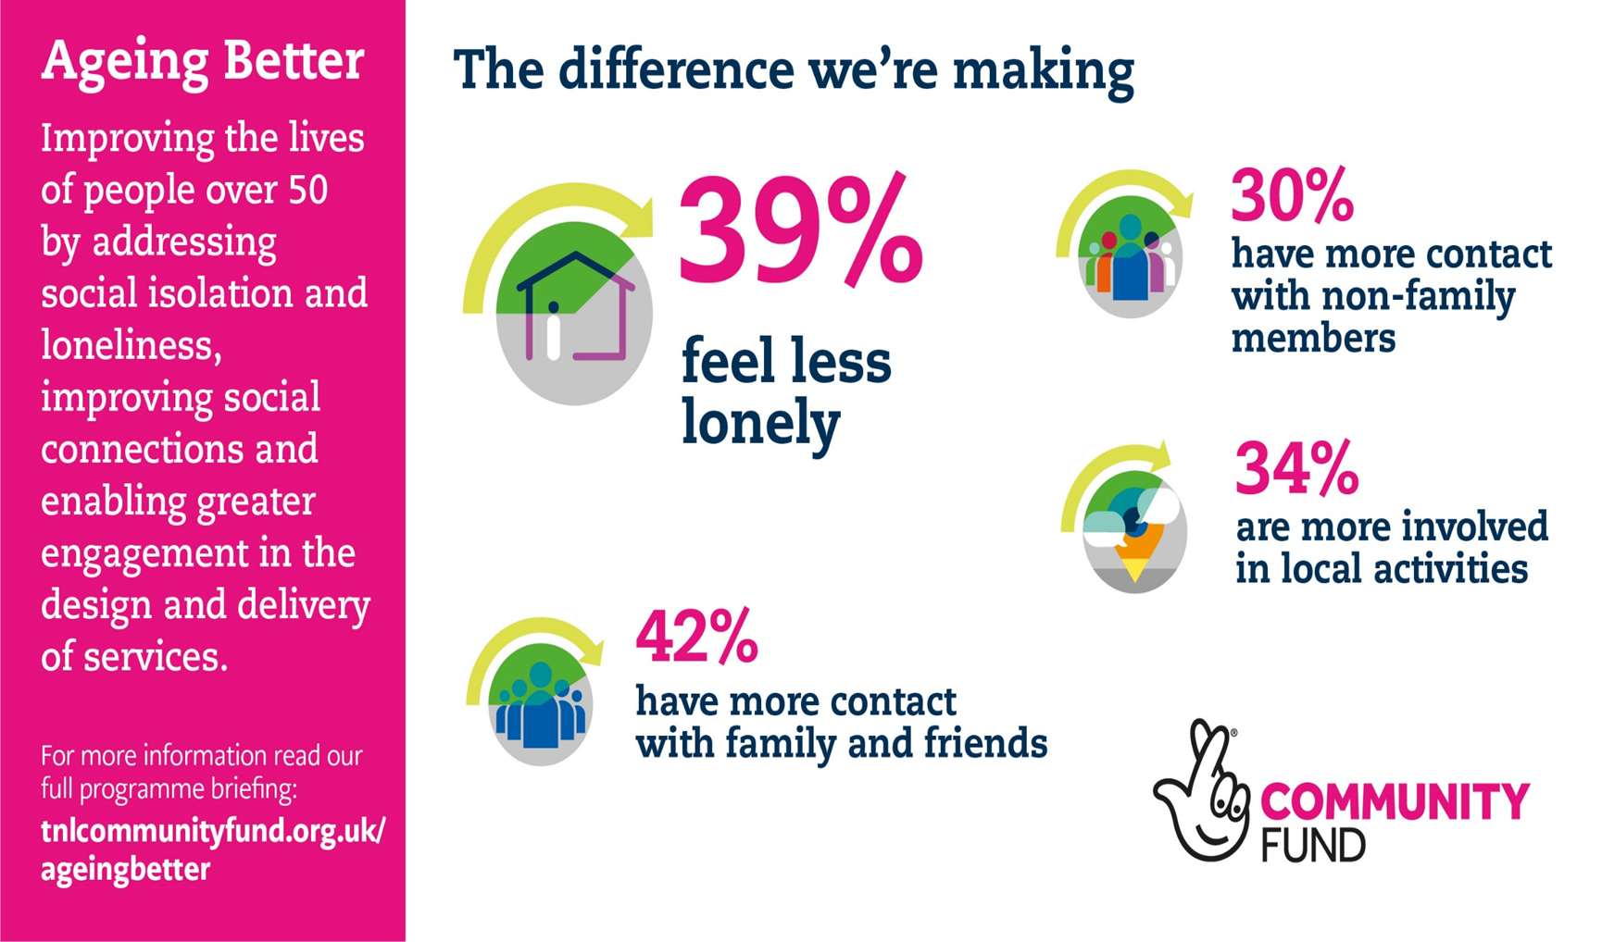
Impact
Ageing Better Legacy and Learning

Slide 4
Learning
Ageing Better Legacy and Learning

